Slide 1
Do Growth Mindset Interventions Impact Students’ Academic
Achievement? A Systematic Review and Meta-Analysis With
Recommendations for Best Practices
Brooke N. Macnamara1 and Alexander P. Burgoyne2
1 Department of Psychological Sciences, Case Western Reserve University
2 School of Psychology, Georgia Institute of Technology

Slide 2
Learning Goals
Growth mindset theory
Notable studies (and their shortcomings)
Study design
Results
Discussion

Slide 3
Growth Mindset Theory
Your mindset can affect how you lead your life
Fixed vs. Growth
Growth mindset is appealing
Does it even work?
(Blackwell, Trzesniewski, and Dweck, 2007) - Growth mindset prevents grade decline?
(Sisk et al., 2018) - Meta-analysis of 38 independent samples… troubling results
Notes:
Fixed mindset - intelligence and other characteristics are relatively stable. Want to appear smart, avoid effort, and refrain from challenges.
Growth mindset - malleable, focus on learning, and seek challenges. Embrace mistakes and are resilient to setbacks.
Promoting a growth mindset seems to be a simple solution for educators. Mindset Works received a 3.5 million grant.

Slide 4
Sisk et al. Continued
Many studies failed manipulation checks
⅓ failed to show/test students developing a growth mindset
Students may sniff out experiment
Intelligence is very subjective
Other studies show that growth mindset account for < 1% persistence resilience (possibly even detrimental)
Notes:
Many studies fail to perform manipulation checks, and developing a growth mindset should be the treatment, but its hard to test. In fact, many fail to develop a growth mindset and see benefits from positive encouragement.
Students may also wish to perform better when they know they are expected to perform better. Intelligence as a metric is subjective. All results are extremely weak and sometimes even detrimental.

Slide 5
Present Study
First systematic and comprehensive literature review on growth mindset intervention (GMI) on academic achievement
3 meta analyses:
Does GMI promote academic achievement
Is GMI the underlying mechanism
Is GMI the underlying mechanism with highest-quality studies

Slide 6
Best Practices in Intervention Design
Intervention compared to an active control condition
No other differences between treatment and control
A priori power analysis
Random assignment at individual level
Blinding
Test if interventions changed mindsets

Slide 7
Best Practices in Documentation, Analyses, and Reporting
Preregistration
Reporting participation
Reporting all subsamples

Slide 8
Best Practices in Avoiding Financial Conflicts of Interest
There are possible conflicts of interests in performing honest research and making money.
Growth mindset researchers with financial incentives may be less likely to question violations of best practices.

Slide 9
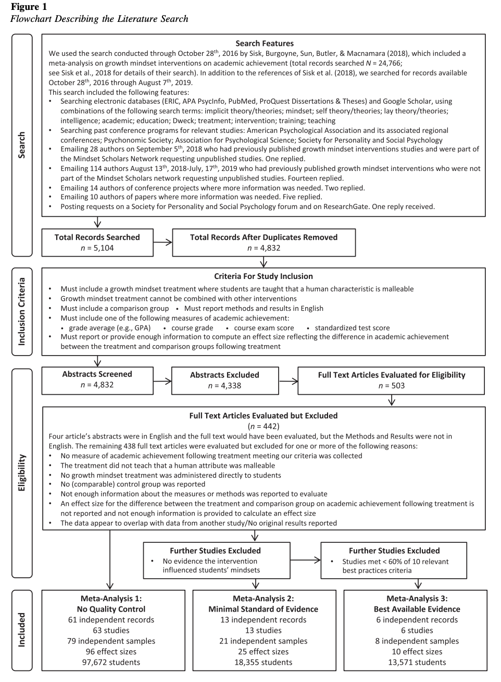
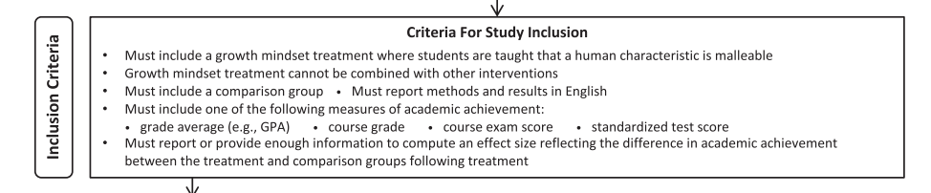
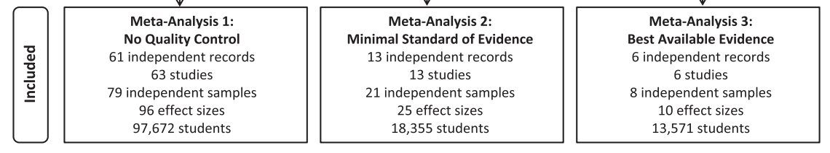
Data Collection with Filters
4,832 unique articles
503 after screening
Notes:
First, they filter the current literature to find papers related to growth mindset.
Then, they narrowed it down with inclusion criteria.
Finally, they did 3 meta-analysis of the given literature with increasing amounts of best practices.

Slide 10
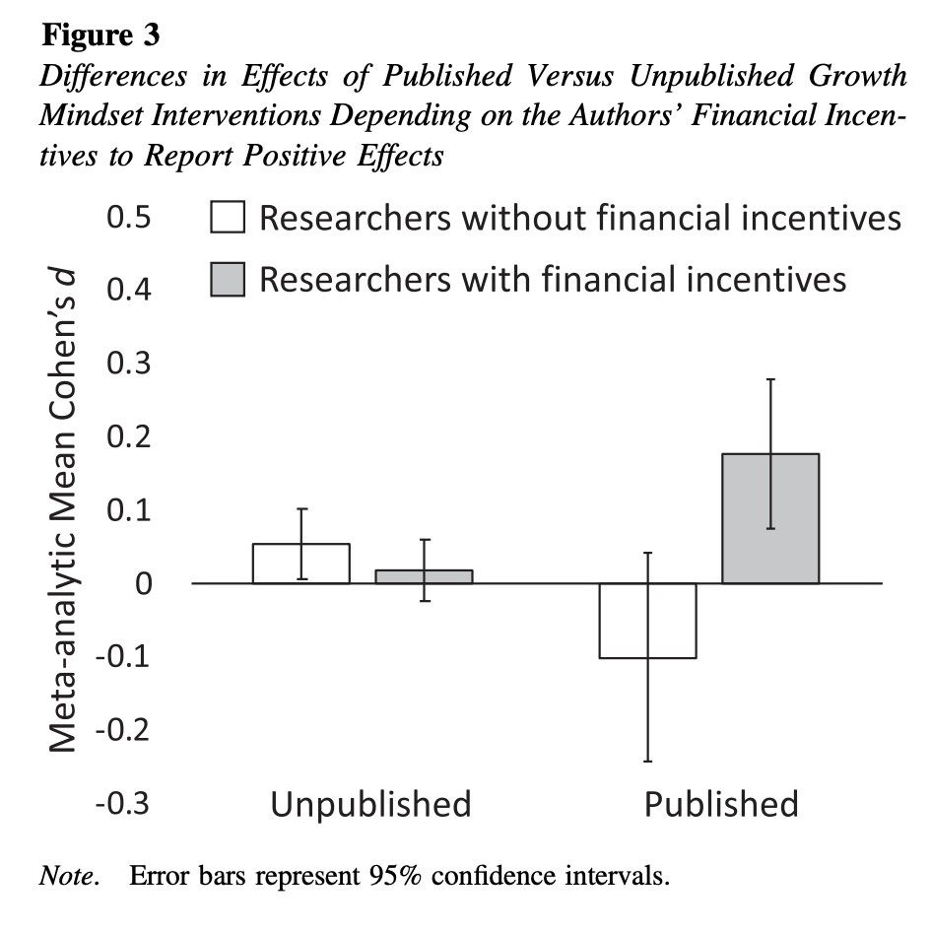
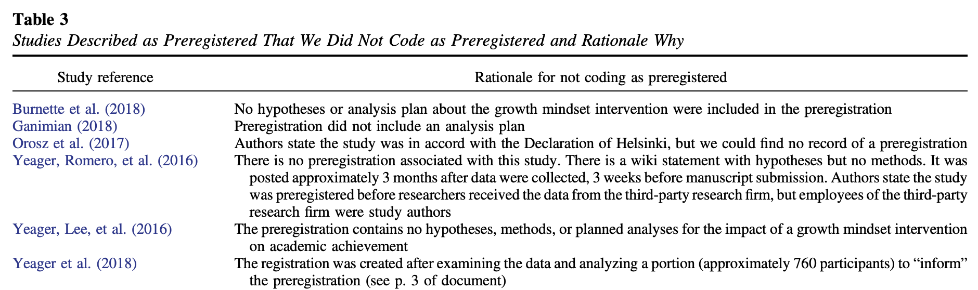
Suspicious Behavior

Slide 11
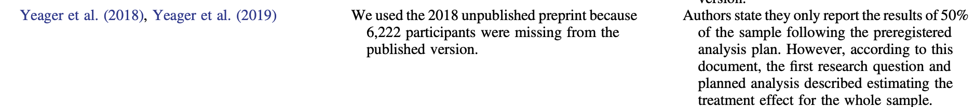
Suspicious Behavior

Slide 12
Study 1: No Quality Control
Method:
Meta-Analysis 1 included all relevant studies from our comprehensive search, regardless of quality.
Results:
The overall effect of growth-mindset interventions in this model, if not accounting for publication bias, was small and statistically significant: d = 0.05
This corresponds to a 98% overlap between the control and the intervention.
It is less when taking into account publication bias.
Results did not differ significantly for low-SES students

Slide 13
Meta-Analysis 2: Minimal Standard of Evidence
Method:
Leniently, the authors included studies that demonstrated mindset being changed to a growth mindset. (25/96 effect sizes).
Results:
There was no significant growth mindset intervention effect on academic achievement
There were not enough papers with financial incentives to conduct a moderator analysis (lack of best practices).

Slide 14
Meta-Analysis 3: Best Available Evidence
Method:
Use the 10 best practices before (e.g. blinding, careful control, all samples reported, etc.) to filter out papers. No papers had more than 8. Only six papers had more 5.
Results:
When examining these interventions, there was no significant growth mindset intervention effect on academic achievement.
Since not all best practices are equal, they tried 230 different combinations of best practices with 3 or more best practices and at least 5 papers. After correcting for publication bias,there were no significant models

Slide 15

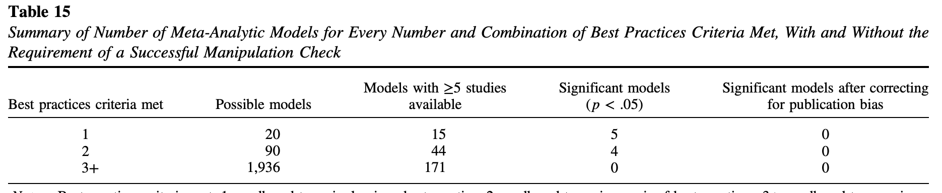
Mcnamara et. al
Growth Mindset Research

Slide 16
Limitations
Limited amount of research in the timeframe when the meta-analysis was conducted.
Only English documents.
Quality of included studies is lacking.

Slide 17
Discussion
Is growth mindset intervention helpful? Not well supported.
“Growth mindset is a recursive process over time.” Not well supported.
“Growth mindset helps struggling students.” Not well supported.
At the end of the day, future research needs to be done with better design practices
Avoid hype
Weigh potential harms and benefits

